Slide 1
Demographic Stochasticity
Eric Scott

Slide 2
Bank Swallows
I misinterpreted the data!
A “colony” is an entire area with many burrows. Colonies can be 10s – 1000s of individuals.
An “extinct” colony is an area of river bank that becomes completely uninhabited the following year.

Slide 3
Group living
Advantages of group living:
- Cooperation (avoid predators) - Lower probability of stochastic extinction
Possible costs of group living:
- Faster accumulation of parasites in large colonies - More conspicuous to predators

Slide 4
Possible causes of extinction
Demographic stochasticity
Fluctuations in the number of organisms that occurr due to sampling error (random chance) alone.
If populations are small, this can be very serious
Colonies degrade over time
e.g. buildup of parasites
Colonies washed out by floods
Other changes in land use

Slide 5

Demographic stochasticity model
A Binomial distribution predicts probabiloity of extinction by chance alone
Assume “event” ($k$) is failure of one burrow, with probability $p$.
“Extinction” is failure of all burrows in a colony ($k=N$)

Slide 6
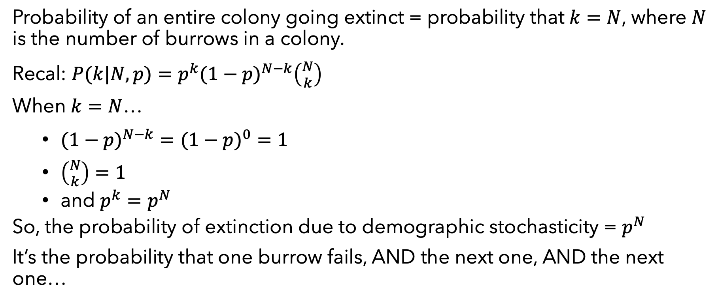
Demographic stochasticity model
Probability of an entire colony going extinct = probability that $k=N$, where $N$ is the number of burrows in a colony.
Recal: $P(k|N,p)=p^{k}(1−p)^{N−k}\left({N \atop k}\right)$
When $k=N$…
$(1−p)^{N−k}=(1−p)^{0}=1$
$\left({N \atop k}\right)=1$
and $p^{k}=p^{N}$
So, the probability of extinction due to demographic stochasticity = $p^{N}$
It’s the probability that one burrow fails, AND the next one, AND the next one…

Slide 7
Linearizing effect of link functions
A link function turns a non-linear problem into a linear one, which makes it easier to solve.

Slide 8
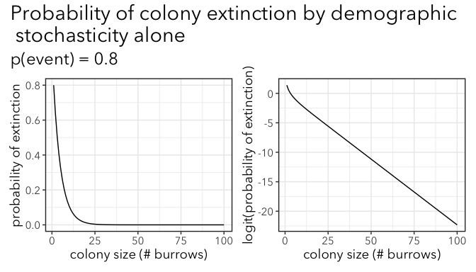

Slide 9
Linearizing effect
The relationship between extinction probability and colony size remains linear across a range of values for p(event).

Slide 10
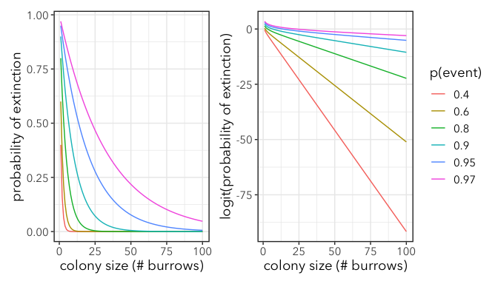

Slide 11
Is colony extinction stochastic or related to colony size?
Stochastic vs. related to effects of group living
Different form of this dataset…
birds2 <- read_csv(here("data", "BankSwallows2.csv")) head(birds2)
## # A tibble: 6 x 2 ## num.burrows ext ## <dbl> <dbl> ## 1 40 1 ## 2 30 1 ## 3 260 1 ## 4 70 0 ## 5 170 1 ## 6 80 1
Each row is a colony, with the number of burrows (holes) and column for extinction. 1 = went extinct, 0 = didn’t go extinct.

Slide 12
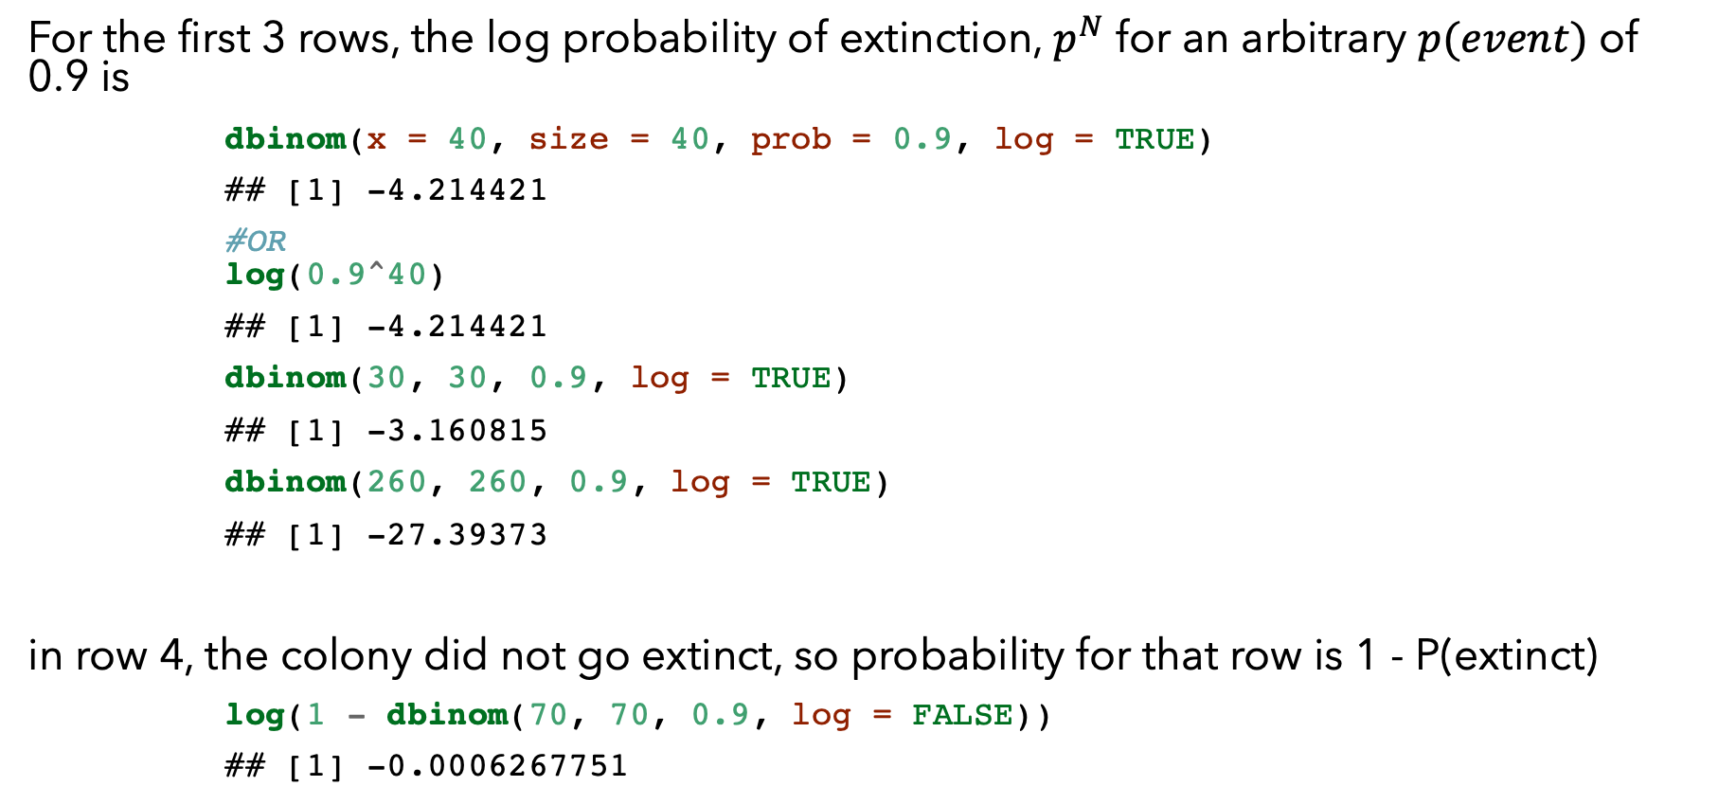
Demographic stochasticity model
For the first 3 rows, the log probability of extinction, $p^{N}$ for an arbitrary $p(event)$ of 0.9 is
dbinom(x = 40, size = 40, prob = 0.9, log = TRUE)
## [1] -4.214421
#OR log(0.9^40)
## [1] -4.214421
dbinom(30, 30, 0.9, log = TRUE)
## [1] -3.160815
dbinom(260, 260, 0.9, log = TRUE)
## [1] -27.39373
in row 4, the colony did not go extinct, so probability for that row is 1 - P(extinct)
log(1 - dbinom(70, 70, 0.9, log = FALSE))
## [1] -0.0006267751
## num.burrows ext ## <dbl> <dbl> ## 1 40 1 ## 2 30 1 ## 3 260 1 ## 4 70 0

Slide 13
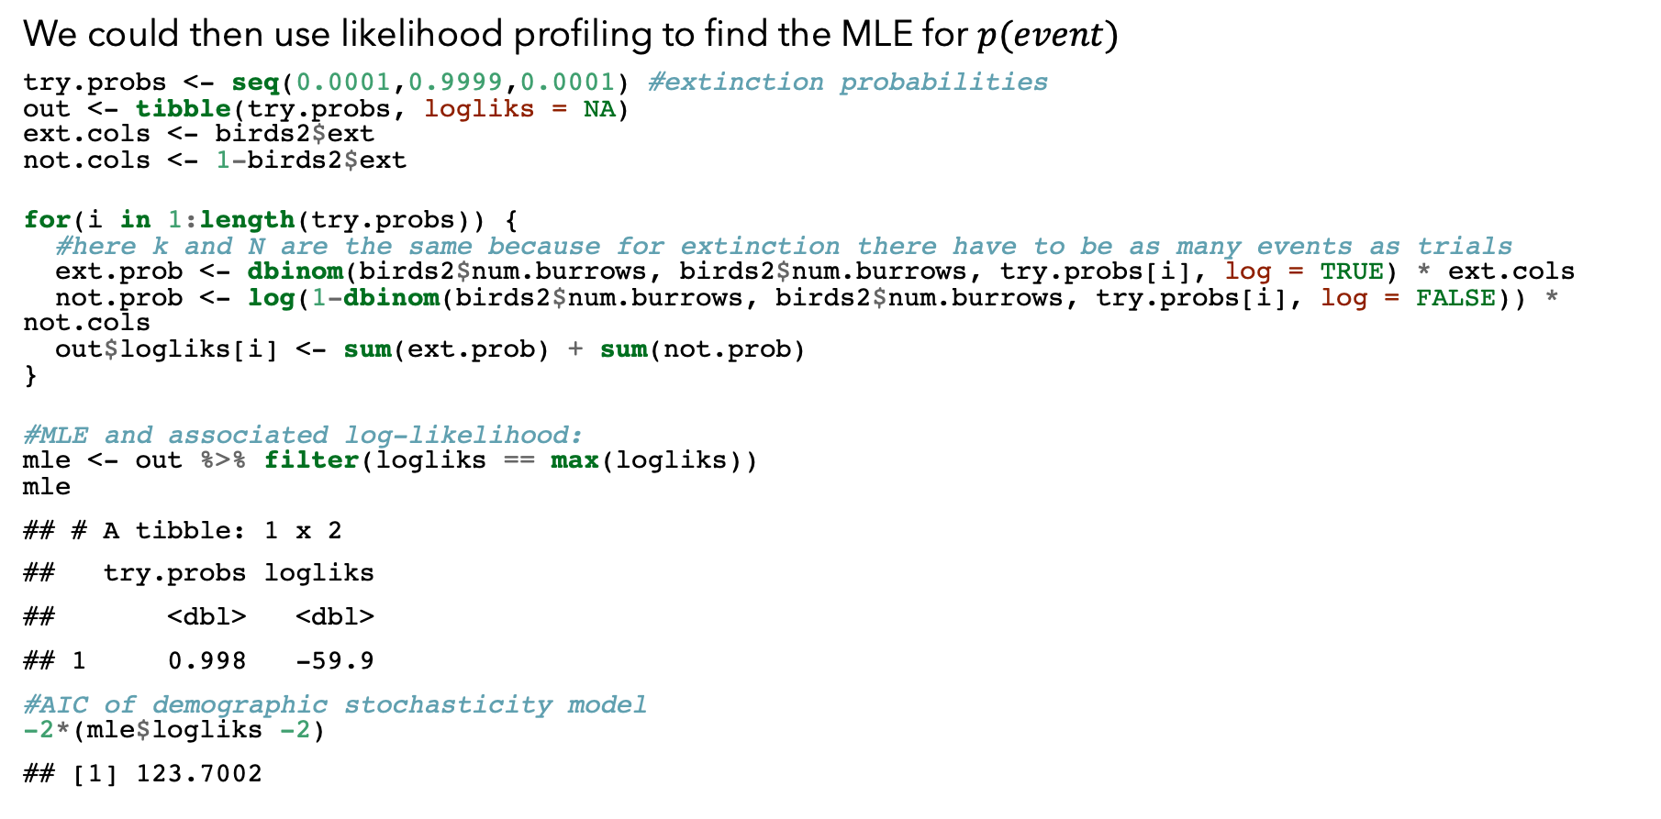
Demographic stochasticity model
We could then use likelihood profiling to find the MLE for $p(event)$
try.probs <- seq(0.0001,0.9999,0.0001) #extinction probabilities out <- tibble(try.probs, logliks = NA) ext.cols <- birds2$ext not.cols <- 1-birds2$ext for(i in 1:length(try.probs)) { #here k and N are the same because for extinction there have to be as many events as trials ext.prob <- dbinom(birds2$num.burrows, birds2$num.burrows, try.probs[i], log = TRUE) * ext.cols not.prob <- log(1-dbinom(birds2$num.burrows, birds2$num.burrows, try.probs[i], log = FALSE)) * not.cols out$logliks[i] <- sum(ext.prob) + sum(not.prob) } #MLE and associated log-likelihood: mle <- out %>% filter(logliks == max(logliks)) mle
## # A tibble: 1 x 2 ## try.probs logliks ## <dbl> <dbl> ## 1 0.998 -59.9
#AIC of demographic stochasticity model -2*(mle$logliks -2)
## [1] 123.7002

Slide 14
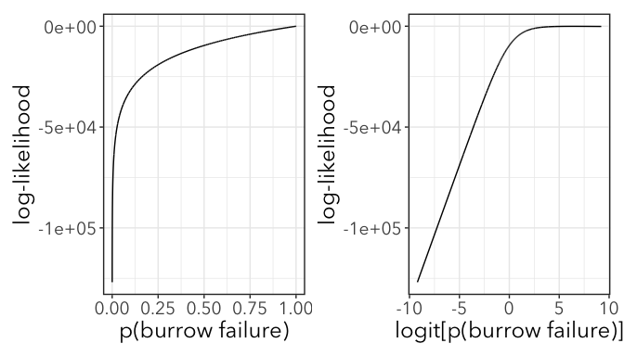
Likelihood profiles

Slide 15
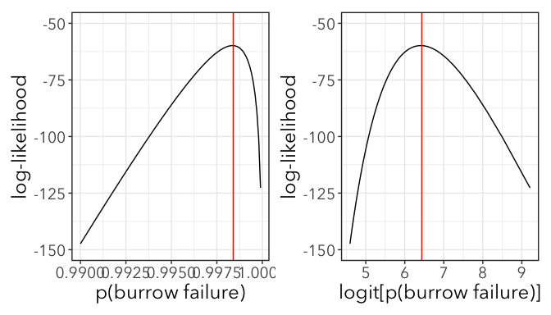
Likelihood profiles

